Slide 1
Component-Based Software Engineering (CBSE) (methodology) & Computer-Aided Software Engineering (tools)(CASE)
Chapter 12

Slide 2
Lesson Objectives
Explain the 4 main activities in CBSE process
Evaluate the use of CBSE approach – Benefits and Obstacles

Slide 3
Introduction
Component-based software engineering (CBSE) is a process that emphasizes the design and construction of computer-based systems using reusable software “components”.
E.g.:
Reuse the programs / screens from
previous projects/ Assignments

Slide 4
Introduction
Establish SRS,
Architectural design
Examine any components
can be reused?
Yes
No
CBSE
Use conventional or O-O SE to develop new components
- Component Qualification
- Component Adaptation
- Component Composition
- Component Update

Slide 5
4 Activities in CBSE

Slide 6
CBSE Activities
Component Qualification
Component Adaptation
Component Composition
Component Update

Slide 7
CBSE Activities – Component Qualification
Use a process of discovery and analysis to qualify each component’s fit in architecture and requirements.
Ensures that a candidate component will perform the function required
Before a component can be used, factors need to consider includes: the run-time requirements, services requirements, exception handling, security features etc

Slide 8

CBSE Activities – Component Adaptation
Components adapted to meet the needs of architecture or to remove architectural mismatches, and be replaced by more suitable components
In reality, qualified component for use may exhibit conflict in one or more of the areas.

Slide 9
CBSE Activities – Component Adaptation
To mitigate against these conflicts, an adaptation technique called component wrapping is often used.
white-box wrapping
examines the internal processing details of the component and makes code-level modifications to remove any conflict.
Not for the case when COTS components are used.
grey-box wrapping
applied when the component library provides a component extension language or API that enables conflicts to be removed or masked.
black-box wrapping
requires the introduction of pre- and post processing at the component interface to remove or mask conflicts.

Slide 10

CBSE Activities – Component Composition
Assembles qualified, adapted, and engineered components to populate the architecture established for an application.
An infrastructure must be established to bind the components into an operational system.

Slide 11

CBSE Activities – Component Update
When requirements for the system change
Update the components if requirements change / new release available

Slide 12
Benefits & Obstacles of CBSE

Slide 13

Evaluation – Benefits of CBSE
Improve Quality
provides a high-performance & more reliable end product as components have been used many times, each time getting more refined and reliable as they are reused and re-tested.
Increase Productivity
reduces the time required for code development, documentation, system modeling, and planning
Save Cost
reduces development cost from scratch & testing overhead

Slide 14

Evaluation – Obstacles of CBSE
Little training is available to help s/w engineers & mgrs to understand & apply resue
Many s/w practitioners continue to believe that reuse is “more trouble than it’s worth”.
Few s/w companies to provide incentive to reusable components program
Many companies continue to encourage of s/w development methodologies which do not facilitate reuse.

Slide 15
Computer-Aided Software Engineering (CASE) Technology
3 Level of CASE

Slide 16
CASE Technology
Three different levels of CASE technology can be identified: -
Production-process support technology – support for process activities such as specification, design, testing and etc.
Process management technology – support modeling and process management.
Meta-CASE technology – generators which are used to create production-process and process management support tools.

Slide 17
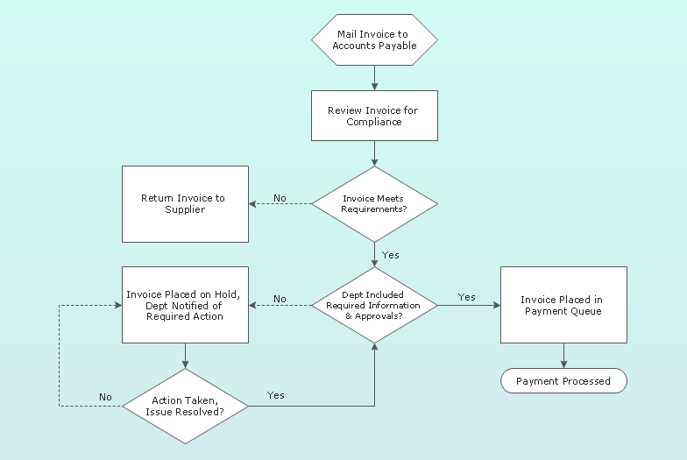
Functional Classification of CASE
Functionality-tools are specified according to the functions they support:
1. Business process engineering tools – trace and track data flows between different original departments. Output of this CASE tool can be a flowchart.

Slide 18

Functional Classification of CASE
2. Process modeling & management tools – e.g. Visio
3. Data modeling tools – DBMS, etc

Slide 19
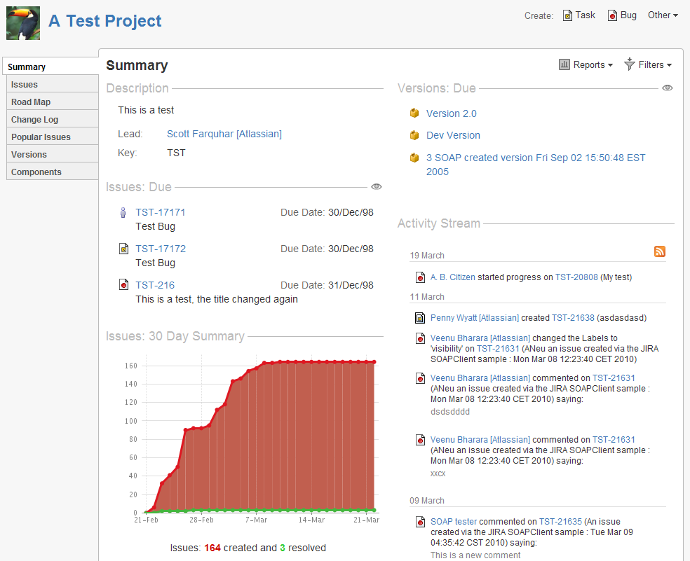
Functional Classification of CASE
4. Project planning/Project management tools – cost /cost and time estimation, e.g. Excel Spreadsheet
Atlassian JIRA project management tool

Slide 20
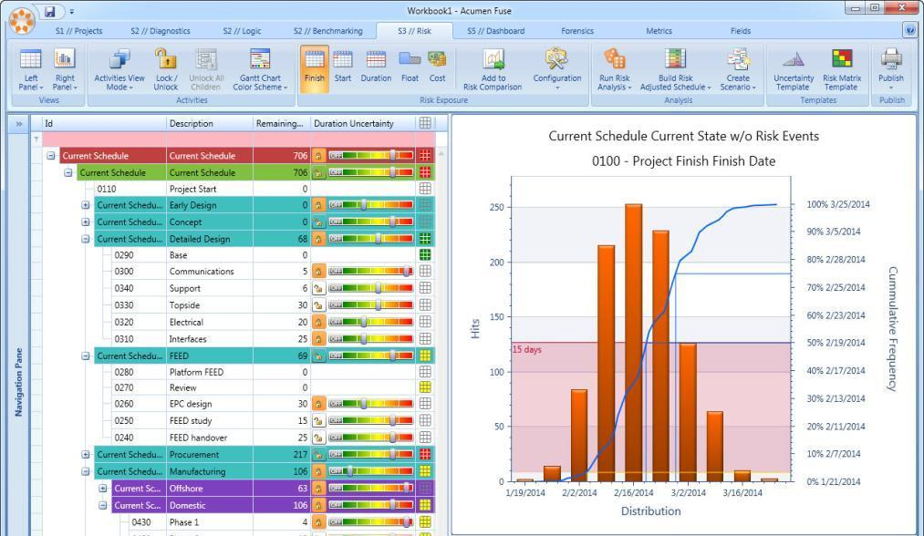
Functional Classification of CASE
5. Risk Analysis Tools – manage project risk
Acumen Risk is a Monte Carlo risk analysis tool combining true cost and schedule risk analysis against a native project plan together with identified risk events from a project risk register.

Slide 21
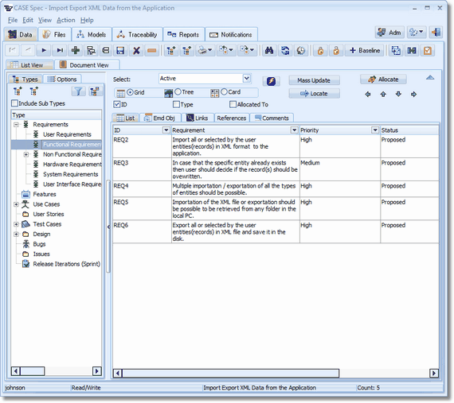
Functional Classification of CASE
6. Requirement Tracing Tools – to ensure functions delivered completely as stated

Slide 22
Functional Classification of CASE
7. Metrics & Management Tools – for software quality measurement
COQUALMO is a tool used to predict the number of residual defects in a software product.

Slide 23

Functional Classification of CASE
8. Prototyping Tools - user interface generators, e.g. VB
UI generator

Slide 24
Functional Classification of CASE
9. Editing Tools - text & diagram editors
10. Method support tools – design & code editors, data dictionaries, e.g. IBM Rational Software Architect (RSA)
11. Language processing tools – compilers, interpreters
12. Debugging tools – interactive debugging systems

Slide 25
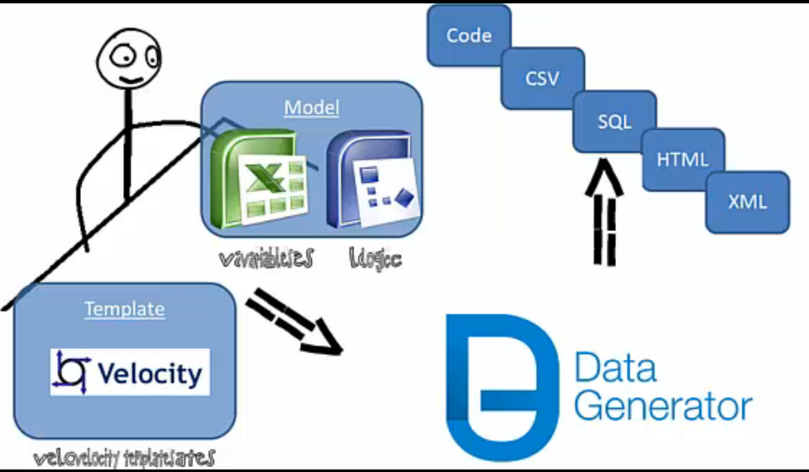
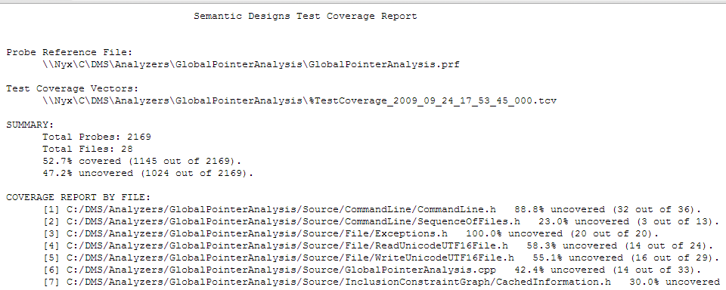
Functional Classification of CASE
13. Testing Tools - test data generators, test coverage analysis and reporting
Notes:
Data Generator is a tool to automatically generate test data from model and template. Even if requirements are changing, test data can be changed automatically.

Slide 26
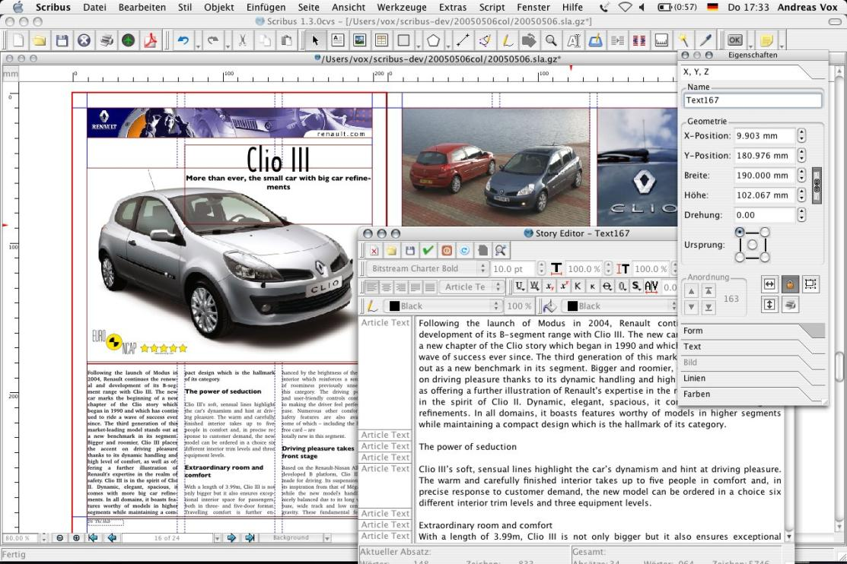
Functional Classification of CASE
14. Documentation Tools - page layout programs, image editor
Scribus – page layout program

Slide 27
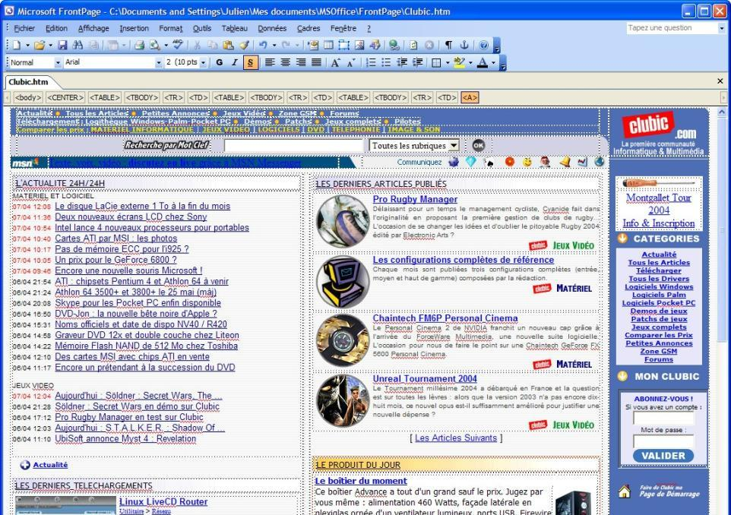
Functional Classification of CASE
15. Web Development Tools
e.g. FrontPage

Slide 28
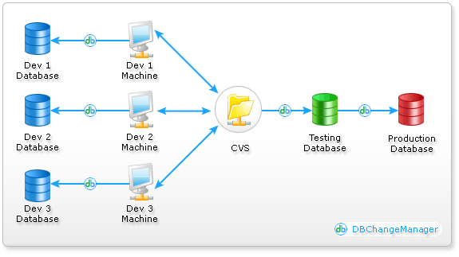
Functional Classification of CASE
16. Software Configuration Management Tools – e.g. SQL Server DB Change Management, Version & Change Management
SQL Server Database Change Management:

Slide 29
Other Classification of CASE

Slide 30

Other classification of CASE
Can also be classified by Breadth of Support (Fuggetta, 1993)
Tools – support individual tasks (stand alone tool) like compiler, word processor and etc
Workbenches – support process phases or activities like specification, analysis, design and etc. Normally, include a few tools.
Environment – support all or at least a substantial part of s/w process. Normally, include several workbenches that integrated together.

Slide 31
CASE Life Cycle

Slide 32
CASE Life Cycle
Procurement
Tailoring
Introduction
Obsolescence
Evolution
Operation

Slide 33
CASE Life Cycle
The stages of the CASE life cycle are:-
Procurement – choose an appropriate CASE system
Tailoring – adapts a CASE system to a particular set of organization or project requirements
Introduction – introduces the CASE system into a working context

Slide 34
CASE Life Cycle
The stages of the CASE life cycle are:-
Operation – the CASE system is in everyday use for software development
Evolution – modifying the h/w or s/w to adapt to new requirements
Obsolescence – the CASE is taken out of use. Need to ensure that the s/w developed using the system can still be supported by the org.

Slide 35
Issues in CASE Life Cycle

Slide 36
Issues in CASE Life Cycle – 1. Procument
The factor which must be taken into account when procuring a company-wide CASE system are: -
Existing company standards and methods – Visio supports SSADM convention?
Existing computers and future computer procurement
– memory, CPU, OS

Slide 37
Issues in CASE Life Cycle – 1. Procument
The factor which must be taken into account when procuring a company-wide CASE system are (cont’): -
The class of applications to be developed – choose a CASE that provides facilities for developing the type of applications required by an org.
Security – provide any security features?
Cost – expensive? Within budget?

Slide 38
Issues in CASE Life Cycle – 2. Tailoring
The activities required to customize a CASE system for a particular organization and application domain include:-
Installation – installed & tested on org’s h/w
Process model definition – allows CASE mgr to see where the tool can be applied & what interfaces to other tools may need to be constructed
Tool integration – develop interface modules to integrate different tools
Documentation

Slide 39

Issues in CASE Life Cycle
Introduction
1. User Resistance
2. Lack of Training
3. Management Resistance
Operation

